Slide 1

Simulated Dataset for the Loaded vs. Unloaded UAV Classification Problem Using Deep Learning
Hamid Azad*, Varun Mehta, Miodrag Bolic*, Iraj Mantegh
* University of Ottawa
 National Research Council Canada (NRC)

Slide 2
Contents
Introduction
Simulated dataset using AirSim
Statistics about the dataset
Loaded vs. unloaded drone classification problem
Simulation results
Conclusion

Slide 3
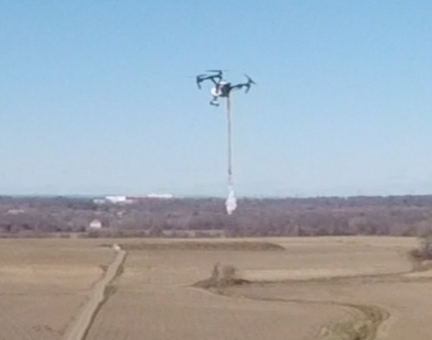
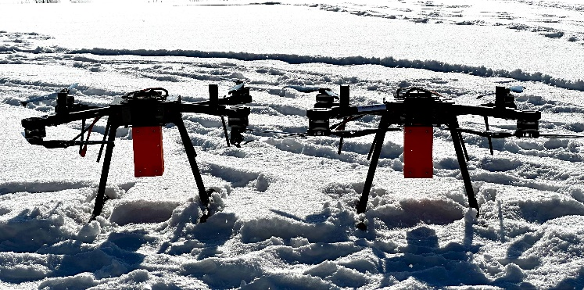
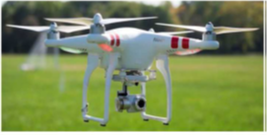
Introduction
Uncrewed or Unmanned Aerial Vehicles (UAVs), also known as drones, and their vast usage in various applications
Serious concerns about safety and security issues such as transporting smuggled goods and other illegal substances
The necessity of addressing the loaded vs. unloaded drone classification problem

Slide 4
Introduction
Various sensors to detect the drone’s payload
Radar: using micro-Doppler signature
Acoustic: using Mel-Frequency Cepstral Coefficients (MFCC)
Vision Camera
Several advantages, including affordability, compact implementation, and lower power consumption
Deep learning-based classifiers and the necessity of having a huge amount of data
Data through real tests is costly and time-consuming
Simulation is the solution! Providing controlled condition
j

Slide 5
Simulated dataset using AirSim
AirSim: an open-source simulation tool developed by Microsoft, that enables the simulation of drones and cars in diverse environments.
Only one simple quadcopter available as the default model
Importing several types of drones into AirSim
Preparing the 3D model in Autodesk Maya
Five types of drones are imported: DJI Phantom, DJI Mavic, DJI Inspire, DJI FPV, Quadrotor
Considering several types and colors of payload

Slide 6
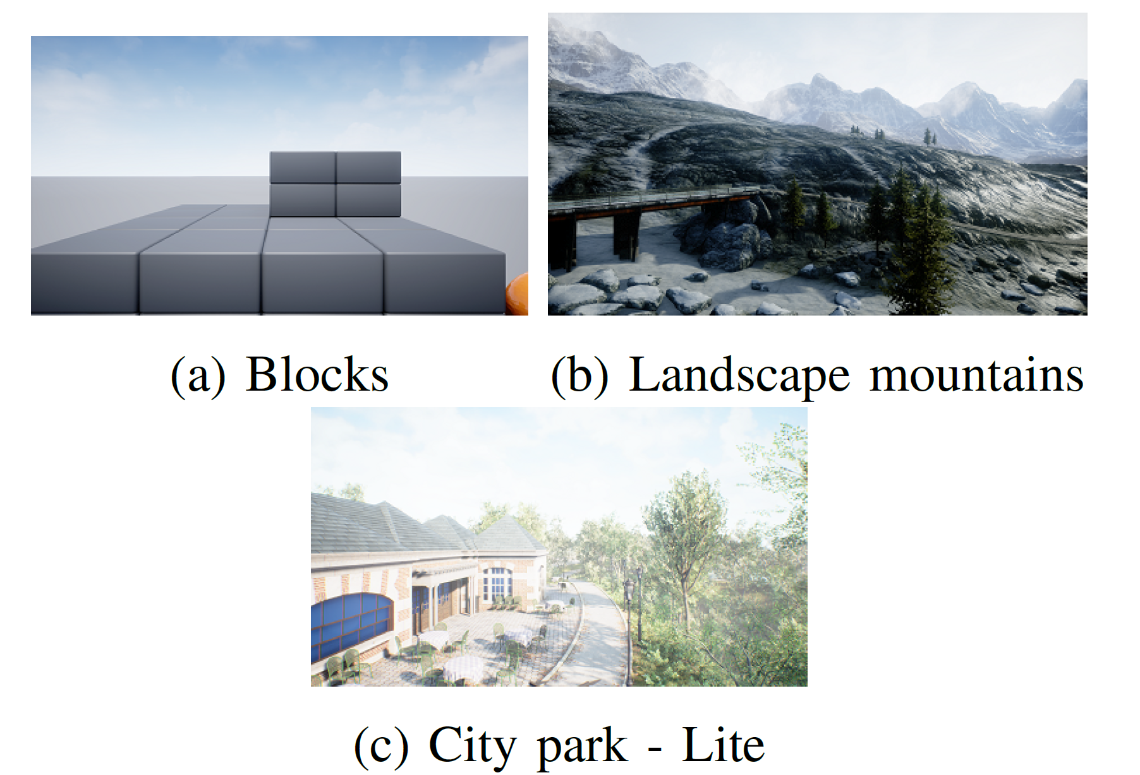
Simulated dataset using AirSim
AirSim: an open-source simulation tool developed by Microsoft, that enables the simulation of drones and cars in diverse environments.
Several environments and backgrounds for dataset diversity
The Blocks environment: the simplest case with a primarily sky background, except when the drone is near the blocks
The Landscape Mountains environment provides a natural setting with trees, rocks, and a lake in the background
The City Park environment offers a blend of natural elements, such as trees, along with man-made objects like buildings. By simulating various backgrounds

Slide 7
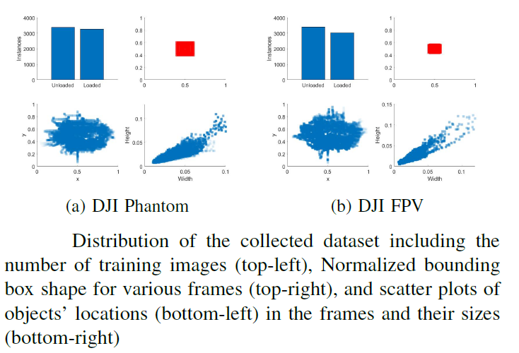
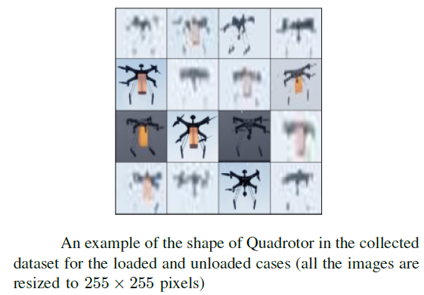
Simulated dataset using AirSim
Dataset specification
Some samples

Slide 8
Loaded vs. unloaded drone classification
Potential to define several problems on the developed dataset
Loaded-vs-unloaded drone binary classification just for a single type of drone
Loaded-vs-unloaded drone classification for the general case of several drone models in the dataset
Classification among various payload forms for the single and/or multiple types of drones (unloaded vs. loaded_{attached} vs. loaded_{hanging})
ResNet-34 as the classifier to address the problem
34-layer deep convolutional neural network in the category of residual networks
Residual architecture to address the gradient vanishing problem in training
Structure inspired by the famous VGGnet architecture

Slide 9
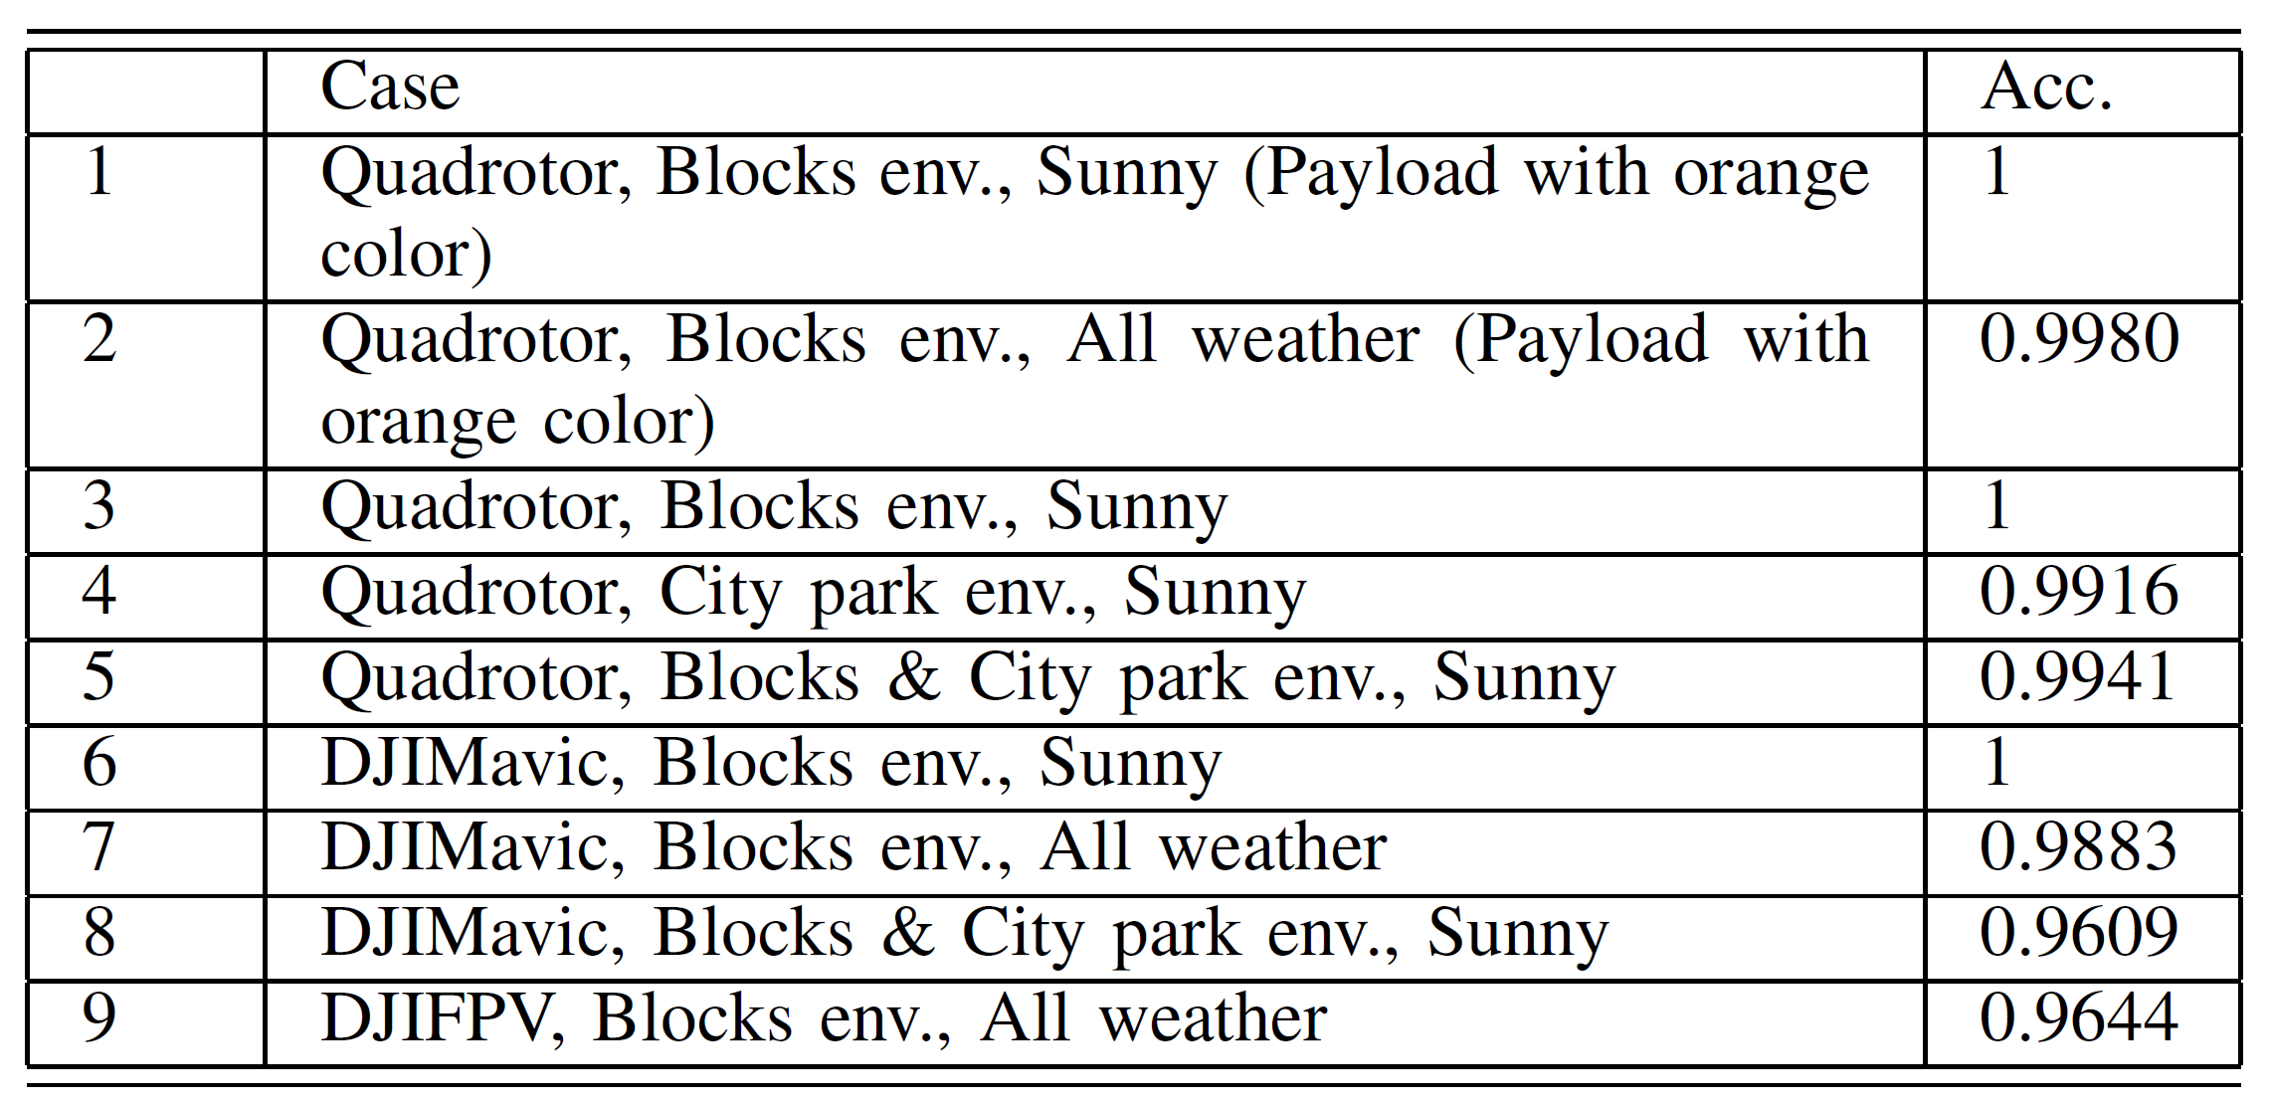
Simulation results
Several cases in the simulated dataset
Splitted data into 70%, 15%, and 15% for the training, validation, and test sets
Number of epochs: 25
Batch size: 64
Learning rate: 0.03

Slide 10
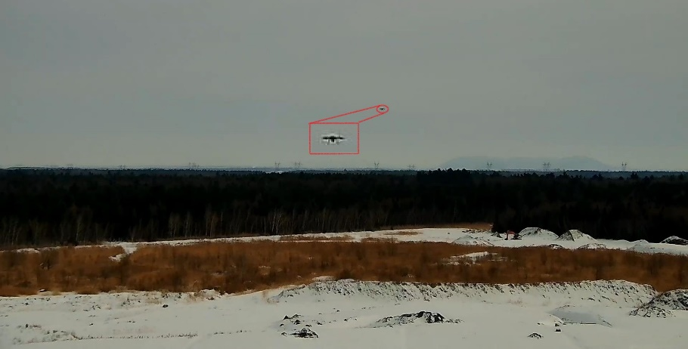
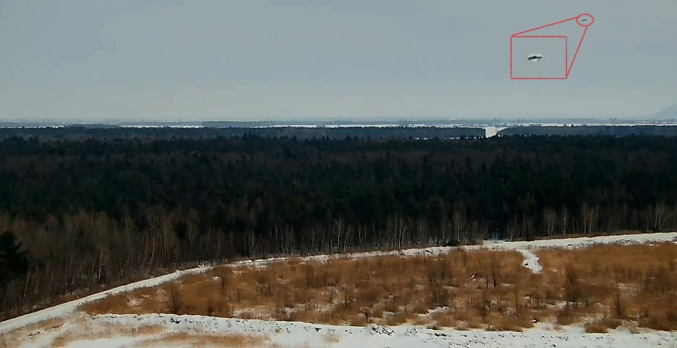
Simulation results
Verification using the practical data
Trained data on the simulated dataset
A quadrotor flying at various distances (from 20 to around 100 meters) from the camera
Box-shaped payload (with dimensions of 7.8 × 9 × 15cm3) was attached underneath the drone
Camera resolution: 1080×1920 pixels
Average occupied pixels by the drone: 20 pixels
Classification accuracy of 98% and 97% for the unloaded and loaded cases
Sample frames for the loaded (up), and unloaded (bottom) cases

Slide 11
Conclusion
The first synthetic dataset specifically designed for the loaded vs. unloaded drone classification
Developed dataset using AirSim:
Incorporating diverse types of drones, environments, payloads, and weather conditions
Using ResNet-34 deep network to address several classification problems within the dataset.
Real-world drone classification: Promising results with the trained network from simulated data
Practical payload detection results confirmed the effectiveness of the synthetic dataset

Slide 12
THANK YOU
Any question?

